Slide 1
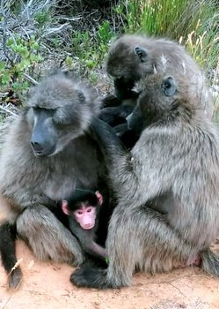
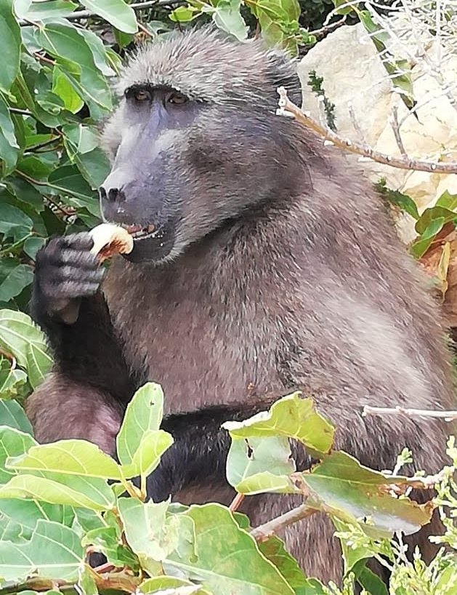
Baboon Coexistence Survey
Rooiels Baboon Indaba

Slide 2
Overview
177 responses (duplicate erfs kept comments only)
163 analysed: 155 owners, 8 resident non-owners
High proportion of questions answered but not all
Comments questions it was erratic (why RE =157); (reason they got in=100); (damage=50)
127 Ideas to stop people feeding baboons – mainly educate but many say Fines if deliberate
“An awareness exhibit might be useful. Something that may interest visitors, but will also educate them”
Notes:
One public flogging!

Slide 3
Rooiels supports biodiversity and majority accept baboons
Biodiversity and wildlife in Rooiels was a factor in my/our decision to buy/move here
Fully agree Agree Neutral Disagree Strongly disagree
Baboons should be free to forage on the coastal fynbos in Rooiels

Slide 4
The baboon troop of Rooiels is part of Rooiels and needs to be accepted and respected
1 Fully Agree 2 Agree 3 Neutral 4 Disagree 5 Strongly Disagree

Slide 5
The baboon situation is out of hand. It calls for new solutions and stricter control
Percentage responses
1 Fully Agree 2 Agree 3 Neutral 4 Disagree 5 Strongly Disagree

Slide 6
How Stressful to live with baboons
Highly stressful | 10
Stressful | 14
Somewhat stressful | 46
Not stressful | 87

Slide 7
What measures do Rooielsers have in place
119 - Baboon proof bin on property
133 - Bars that are no more than 7 cm
OR window restrictors on windows that open
91 - Trellidors/security gates /Shutters
17 - Electric fencing on property
18 - Electric wiring on portion or perimeter of house
136 - Strict house rules to prevent baboon entry
133 - Education of children and visitors on how to behave around baboons
Other – e.g. do not display food; round door knobs; sliders on doors; do not leave bins out; security grill on stoep while eating; keep catty ready; keep dog inside; have signs up inside house

Slide 8
Comments
Comments describing Incidents –
most from those who have had incidents where they are frightened and affected. Most of those who dislike the baboons have had such incidents. Others who have had incidents still like or tolerate the baboons. A few described positive incidents.
With around 2500 comments, every compilation will be different. The focus of the Compilation done was on “mining” the comments for ideas to address issues

Slide 9
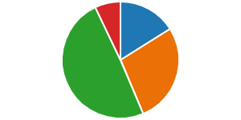
Prefer not come…..
Into House (132) Onto house/car (74) Into Erf (43) Into RE (19)

Slide 10
What does coexistence mean to you The majority say enjoy them and favour coexistence, some ok to coexist if we keep them wild and avoid feeding them & around 20 were negative about coexistence
That we live in harmony with the baboons
Live with them in peace, but keep them wild, do not domesticate them
A wonderful continuing experience
Its a privilege to be able to observe closely and not feel threatened
We regard them as problem animals that have become a pest similar to roof rats. They must be chased out of the village, taught to fear people again and find their food in the veld out of town
It’s my privilege to be this close to baboons, and my responsibility to ensure my property is secure
I believe it will be a massive loss if the baboons are not there anymore
An undeniable risk is that the Baboons are wild animals and can react in a way to hurt or kill a person
To respect the baboons, noting that humans are the issue, not the baboons
Rooiels to remain as it is. People to stop trying to change the village.

Slide 11
What does coexistence meant to you Continued – small sample extract of the different kinds of opinions
It means that I am in a prison and that the baboons are free to do as they want. I don’t want them in the village
Allow the baboon troop to wander freely through the village foraging on the plants and on the beach and rocks. They can be discouraged in the village centre but should be allowed complete freedom elsewhere. People should keep their homes secure and people should manage their waste and learn not to be afraid of baboons. It is possible to learn to manage the situation if a door or window is left open and a baboon has entered.
No monitors. No baboon 'management'. No killing of baboons. No paintball guns. No bear bangers. No HWS presence. Responsible waste management. Education on living in harmony with nature. Baboon-proofing your home and living respectfully. LIVING the Rooiels Vision. Honouring Rooiels' conservancy status through action, not just in words
Anyone found to be feeding baboons should be severely punished

Slide 12
Feeling about baboons (1) 2001 (2) 2018 (3) 2021
 | 2001 | 2018 | 2021
like | 60% | 62% | 59%
tolerate | 20% | 22% | 31%
dislike | 20% | 16% | 10%

Slide 13
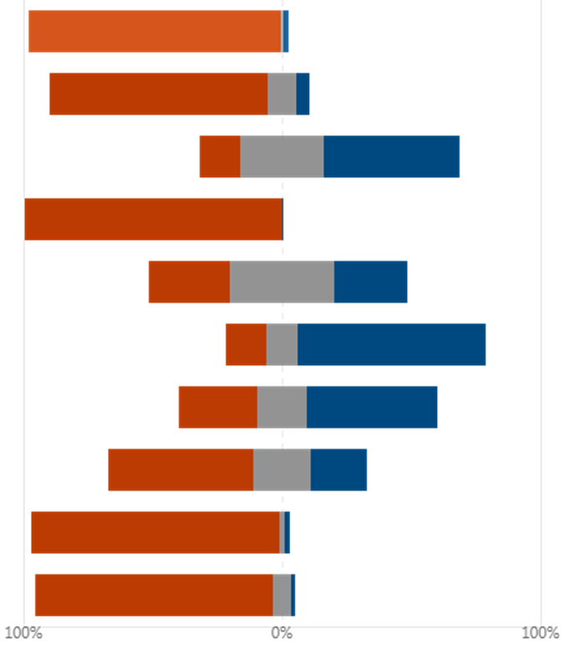
Possible Solutions Very Important; Less Important; N/A
Baboon proof house 97%
Avoid conflict 84%
Use electric fencing 15%
Home waste secure 99%
Employ Temp Info Officers 31%
Employ outside monitors 15%
Remove problem baboon 30%
Work with authorities 56%
Municipal waste secure 96%
New residents inform 92%

Slide 14
Preferred reporting

Slide 15
Nature of the Challenge
Reduce opportunities for human food
Support understanding of baboons, baboon behaviour and appropriate norms to enhance coexistence
Find ways to reduce R44 danger to humans and animals crossing from Klein Rooiels
Provide information to visitors, service providers and residents

