Slide 1
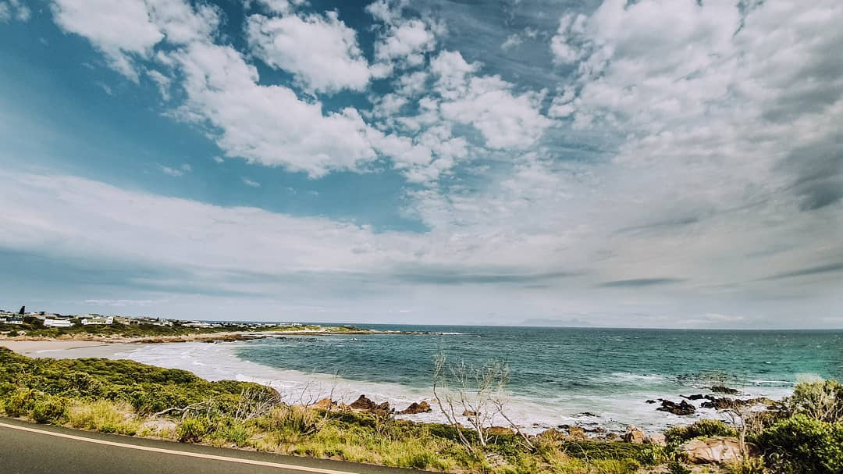
Rooiels:
2010 to 2019
@roxy.j

Slide 2
People
2010
2019
Social
+/- 20% permanent residents
Most >50 years old
125 permanent residents
20-25% <50 years
REC
RERA
Boat Club
REC, RERA, Boat Club
RESA, REDI
WhatsApp: Village People, Block Watch, Patrol Group, Numba 1 Ladies
References: Urban Dynamics WC; May 2010 Survey: Aalbers, Milne, Odendaal,

Slide 3
Land use
2010
2019
Infrastructure
75% stands developed
2 restaurants & shop
3 guest accomm.
81% stands developed
3 restaurants, shop, RESA
28+ guest accomm (Airbnb)
Gravel roads
Adequate water supply, constrained during peak season
Gravel and paved roads
Adequate water supply, frequent leaks
References: Urban Dynamics WC; May 2010 Survey: Aalbers, Milne, Odendaal,

Slide 4
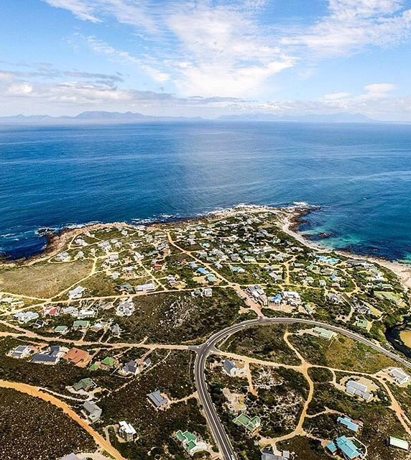
Let’s review the growth of the last ten years, so that we can plan for the next ten years.
@capetownmag

