Slide 1
RERA Report 2022
Highlights and Updates
Read the full report in the Breeze

Slide 2
Our Village
Growing at a rapid pace.
Need to ensure we limit the impact of development on biodiversity and character
Commitment to work with OM for service delivery that reinforces our Vision
Need to share “Living the Vision” – information packs and the website
Information and signage

Slide 3
Breeze
Rapid uptake – available in the Shop while RESA office is closed over the holidays
Printed 176 copies
Possible to print more (in batches of 50 minimum) if needed or for sale
A big thank you to Willie du Plooy for collating, editing, researching and writing.
Rooiels book – no more copies. Still demand

Slide 4
OM Services in Rooiels
Water, roads, storm drains, street names. Thanks to Mr van Rhodie and the team at Kleinmond office for responding as they can
Major pressure on very limited resources
RERA liaises with OM to ensure delivery of broad delivery of services in line with Vision. Individual ratepayers own responsibility for specific issues

Slide 5
Liaison with neighbours
RERA has worked closely with neighbouring ratepayers and conservancy associations and worked together on a range of initiatives and engagements and objections to developments and policies and proposals e.g. lighting overlay
Within Rooiels: earlier ongoing follow-up; current year Erf 84 still going on. Others resolved at the time brought to notice.

Slide 6
Interactions with OM
As reported in the various Ward Feedback messages and meetings centred on Budget, initially 2022/2023 and then on Next 5 year IDP and Budget (see on Website)
There have been several occasions where we are asked to provide the description we have of what the village wants. At each occasion we have referred to the Rooiels Vision and indicated the RECOZ as representing what we want for Rooiels

Slide 7
Meetings with OM
The OM Planning Tribunal is not currently correctly constituted and there are a number of issues still outstanding that will need to be followed up with OM in 2023. including 3 Villages Meeting held on 1st Nov (see Agenda).
Plot Clearing Meeting 5th Dec with the Mayor, Councillor and members of OM administration Minutes available on web

Slide 8
Plot Clearing Policy
Rooiels Formal Objections and issue raised in various fora including Ward Meetings
Worked very closely with wide range as reported – see website for details
To ensure that we are representing views of most villagers a simple quick 3-question survey was circulated. 109 responses.

Slide 9
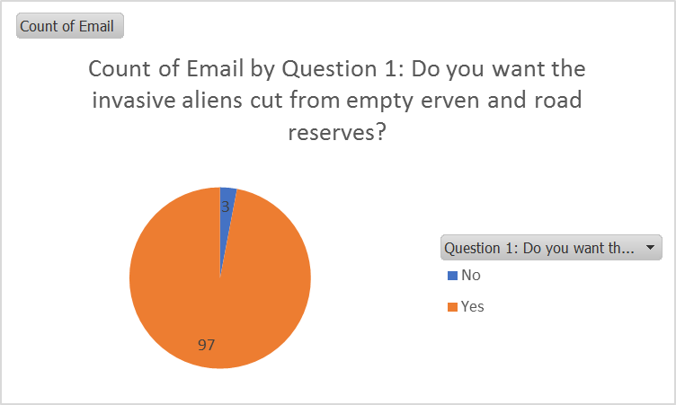
Results of Survey

Slide 10
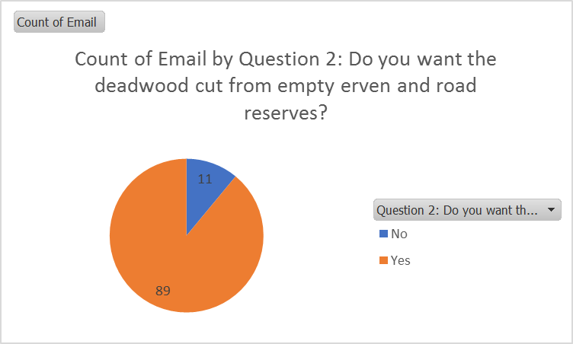
Remove deadwood

Slide 11
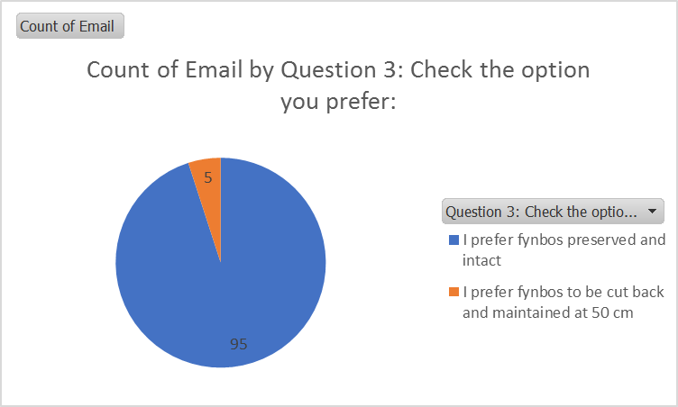
Fynbos intact – or Fynbos cut to 50cm

Slide 12
Other
Constitution
Traffic calming
Community Gardens
CBD baboon information assistants
TEEPSA
Communications
Community Police Forum and Joint Operations Committee(JOCOM)

Slide 13
Thanks
To everyone in the community
To those who have volunteered with baboon bins, slipway, clearing roadsigns, road reserves (cleaning and clearing), gardens, community groups and keeping eyes open and the Holiday Programme
To all the EXCO: Andre, Anuta, Eldie, Lesley and Tracy and also to Gavin for extra support to RERA
To Willie for Communications and Pierre for OM security group representation
To REC that we liaised with closely and to RESA, Rooiels Boat Club and Outreach for all their service

Slide 14
Agenda meeting with Mayor 2nd November 2022
COMPETENCE AND REPRESENTATIVENESS OF THE CURRENT TRIBUNAL
Desirability
Non-compliant applications should not be advertised
The right of groups to object in terms of the by-law
Legal opinions
Notice to owners whose property rights are affected and persons with legitimate interests or expectations
“Blanket” or complete removal of title deed conditions
Inappropriate procedures in considering changes in title deed conditions, changes in land uses / zoning (withdrawal only to submit a second/third application later)
APPLICATIONS OF MEMBERSHIP FOR NEW TRIBUNAL
RESPONSE/REPLIES FROM MAYOR’S OFFICE AND/OR MUNICIPAL OFFICIALS
LACK OF MOTIVATION FOR RATEPAYER INITIATIVES
UNIQUENESS OF THE THREE VILLAGES

Slide 15
Annex - IDP Priorities
2023/2027 Draft IDP Priorities - Rooiels Specific priorities
Priority 2023/27 | Ward 10
 | Cllr. Theresa Els
 | Description | Area
1. | Water pipe replacements | Pringle Bay, Rooiels, Betty’s Bay
2. | Upgrade / New stormwater infrastructure (Rocklands Rd, R44 opp Roella and Porter Drive) | Betty’s Bay, Pringle Bay & Rooiels and Overhills informal settlement
3. | Upgrade of roads | Betty’s Bay, Pringle Bay Rooiels, Overhills & Mooiuitsig
4. | Municipal fleet & equipment to render basic service | Ward 9 & Ward 10
5 | Provision and upgrading of sport and recreation facilities: - Upgrading of existing play park/ Large Playgroung; - Sports ground - New Playground Further upgrades/ rounding-off of Kleinmond Soccer Field / Netball Field (Multipurpose sport facilities) | Mooiuitsig Mooiuitsig Overhills Overhills

Slide 16
9 Dune management
6. | Protection of the Environment: RENR The areas around the coast, at the Kopje and on the Rooiels River estuary (all currently zoned for nature) to be officially proclaimed as protected nature reserve and included as an extension of the Rooiels Nature Reserve | Rooiels
7. | Protection of the Environment and Character of the Area: RECOZ Heritage Overlay Zone to be adapted and extended to ALL of Rooiels – as submitted to OM as RECOZ -- and also Hangklip Conservation Overlay Zone for protecting dark skies | Rooiels – and Pringle Bay and Betty’s Bay
8. | Protection of the Environment: Law enforcement and Waste Management | Ward Wide
10. | Traffic calming, plus R44 Provincial Road | Ward wide

Slide 17
Operational Needs
24. | Maintenance of gravel roads / dust control | Betty’s Bay/ Pringle Bay/ Rooiels /Overhills
25. | Animal proof bin project for residents | Betty’s Bay/ Pringle Bay/ Rooiels
26 | Alien Clearing | Ward Wide
PROVINCIAL / NATIONAL
27 | Roads – traffic calming on R44 esp. at Porter Drive, Rooiels | Ward Wide
28. | Housing | Mooiuitsig / Overhills
30. | Electrification of Overhills | Overhills
30. | High School | Ward 9 & Ward 10
31. | Public Transport | Ward 9 & Ward 10

