Slide 1
The UNESCO MAB Programme in South Africa
Kogelberg Biosphere Reserve and Rooi Els
Ruida Pool-Stanvliet
CapeNature
Rooi Els Ratepayers, 16 November 2019

Slide 2
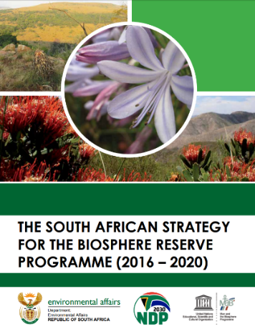
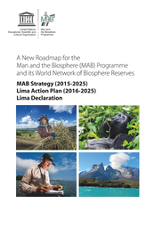
Introduction to MAB
Country agreement with UNESCO – Aug 1995
10 BRs – 9.5% of SA’s land area
Guidelines – global MAB Strategy, Lima Action Plan, SA Strategy for BRs
AfriMAB – SA chair of southern African sub-region
BRs – integrational role for policies, initiatives; collaborative management of sustainable landscapes

Slide 3
MAB in South Africa
DEFF responsible institution, supported by provincial governments
National MAB Committee – since 2010
MAB implemented in soft-law spirit
BR brand outside socio-political debates
Focus on trust, cooperation and improved participation
All BRs = NPCs – mostly volunteer run
Successful in securing donor funding
Continuing funding challenges
Difficulties with horizontal and vertical integration

Slide 4
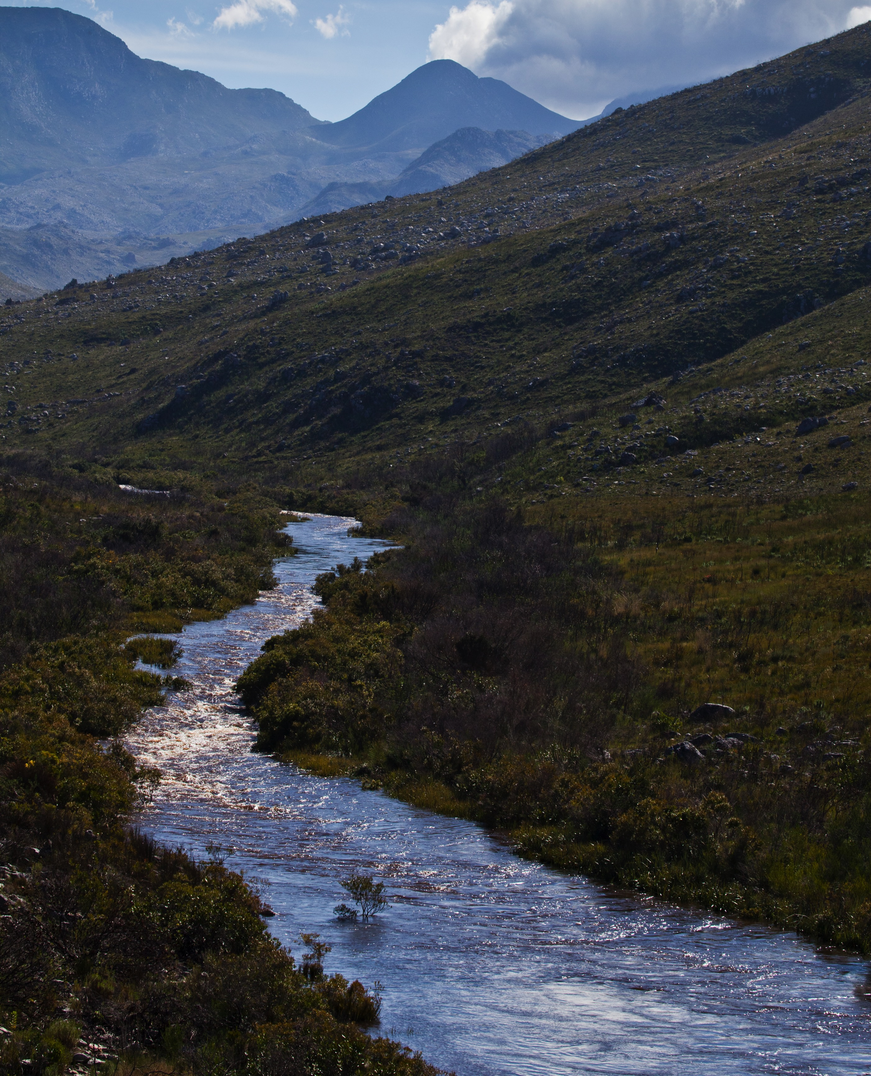
SA Vision:
“South African biospheres are special landscapes where socio-ecological land management is practised towards a more
sustainable future for all”

Slide 5
Biosphere Reserves
3 Functions:
Conservation of biodiversity, ecological processes
Sustainable socio-
economic development
Logistics – research, monitoring,
education, awareness

Slide 6
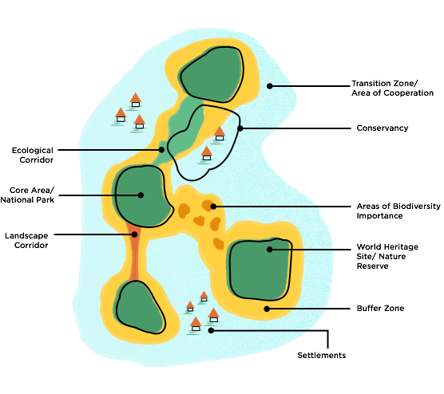

Slide 7
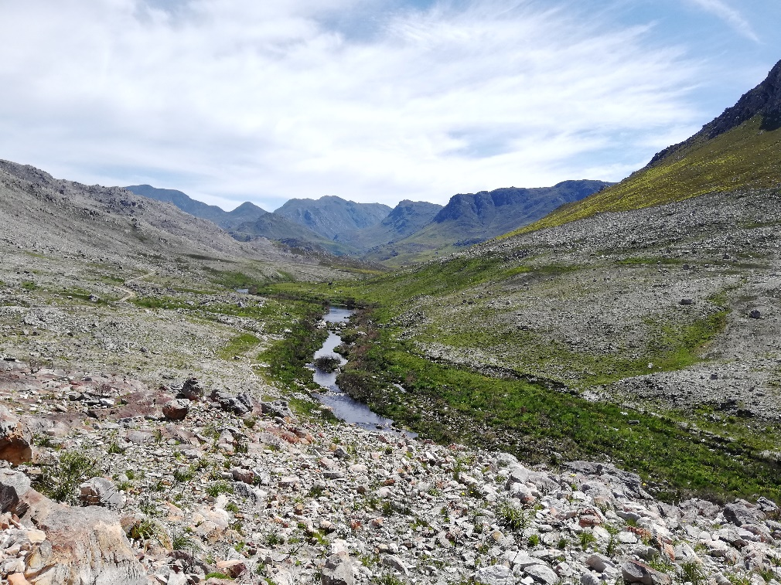
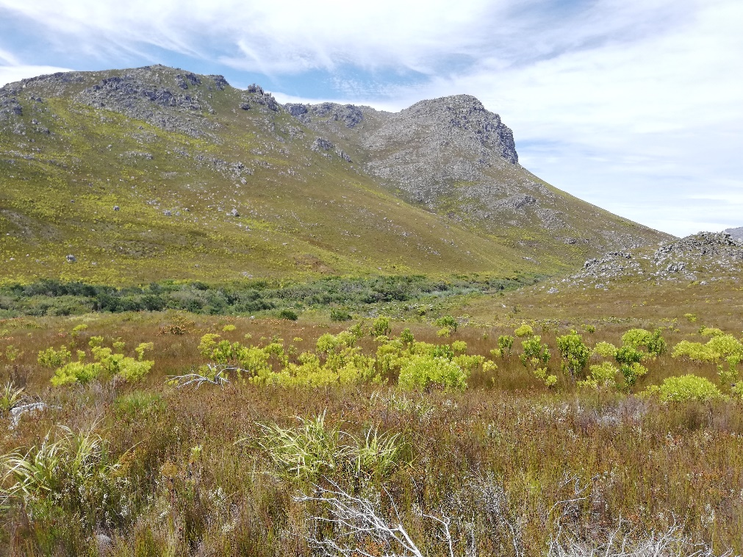
Buffer Zones
Contiguous with, or surrounding the core area
Activities compatible with sound ecological practices of the core area
Clearly delineated
Not necessarily statutory protected status
Could be used to ensure landscape connectivity
Could include human activities (Biosphere Handbook 2007 p. 34, 35)
Rationale for existence to be explained in nomination

Slide 8
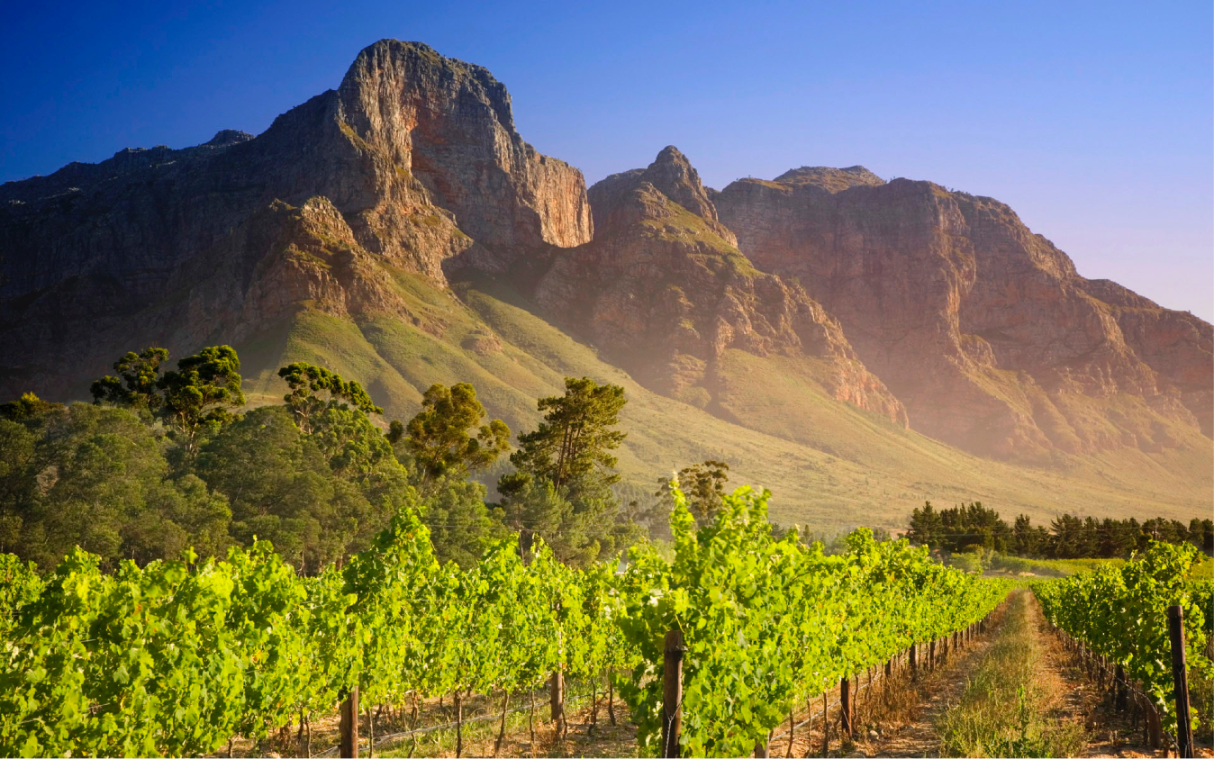
Value of
Biosphere Reserves
International recognition through UNESCO MAB
Aligned to national government outcomes and NDP
Mobilise stakeholders around a shared long-term vision
Beneficial partners in social responsibility programs; sustainable development (SDGs); climate challenges; awareness raising
Provide guidelines for spatial planning, land development, and land use management through municipal and regional SDFs

Slide 9
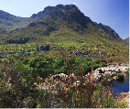
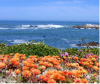
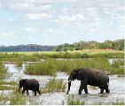
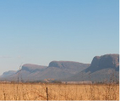
National BR Strategy
UNESCO global MAB Strategy (2015-2025)
Lima Action Plan (2016-2025) adopted at the 4th World Congress of BRs, Lima, Peru, March 2016
National BR Strategy and Implementation Plan (2016-2020):
Aligned with global MAB Strategy
Vision, Mission, Goals, Objectives
Enabling environment
Roles of DEFF, Provinces, Municipalities, BRs = key stakeholders

Slide 10
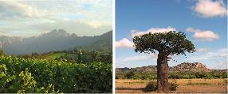
BR Challenges
Legal status
National position and recognition
Integration with spatial planning
Land restitution
Financial needs - especially operational
Buy-in and support

Slide 11
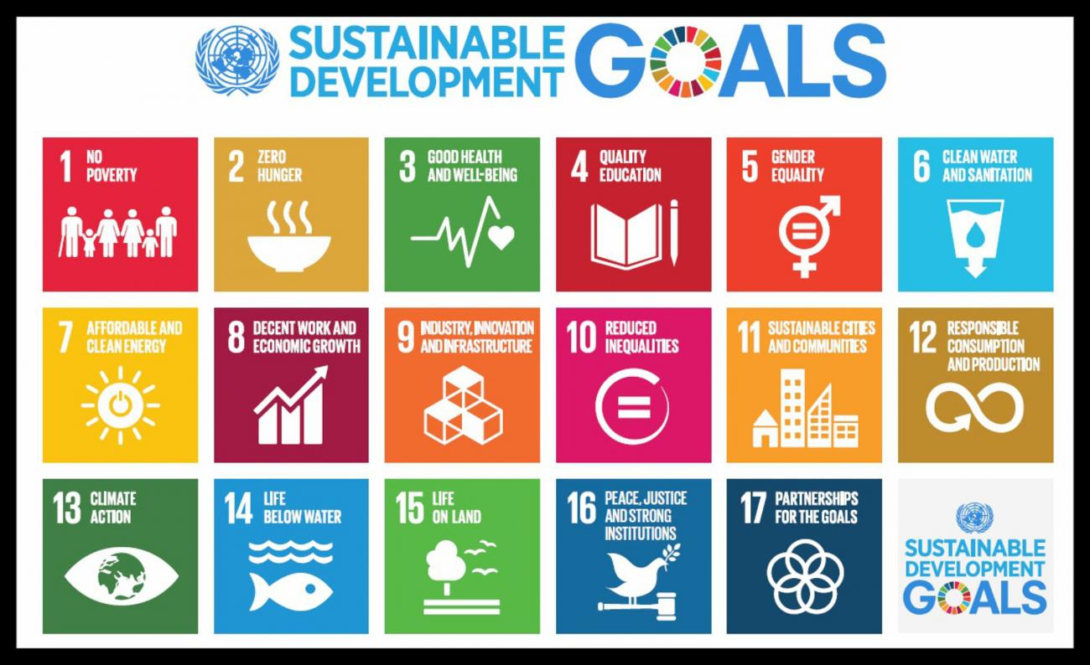
Sustainable development, SDGs and BRs
LAP Action A1 “BRs are recognized as models contributing to the implementation of the SDGs”
SDGs embed all three dimensions of sustainable development (ecological, social, economic)
BR projects showcase contributions of individual BRs to sustainable practices and living landscapes
SDG 1 (No Poverty), 4 (Quality Education), 5 (Gender Equality), 8 (Decent Work and Economic Growth), 10 (Reduced Inequality), 13 (Climate Action), 15 (Life on Land)

Slide 12
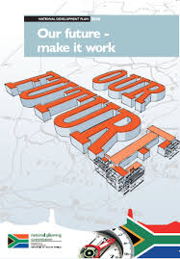
SUSTAINABLE DEVELOPMENT GOALS
Need to be embedded in legislation and policies
SA National Development Plan
Vision: ‘By 2030, SAs transition to an environmentally sustainable, climate change resilient, low-carbon economy and just society will be well under way’

Slide 13
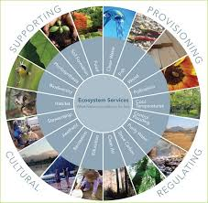
Reflections on future of MAB in SA
Increasing support for MAB
Positive impact in landscapes across 4 pillars of support:
(i) biodiversity conservation, awareness, research
(ii) employment, quality of life
(iii) ecosystem services
(iv) facilitation
Need flexibility and creativity around funding
BRs enable more defensible socio-political decision-making and equitable resource use

Slide 14
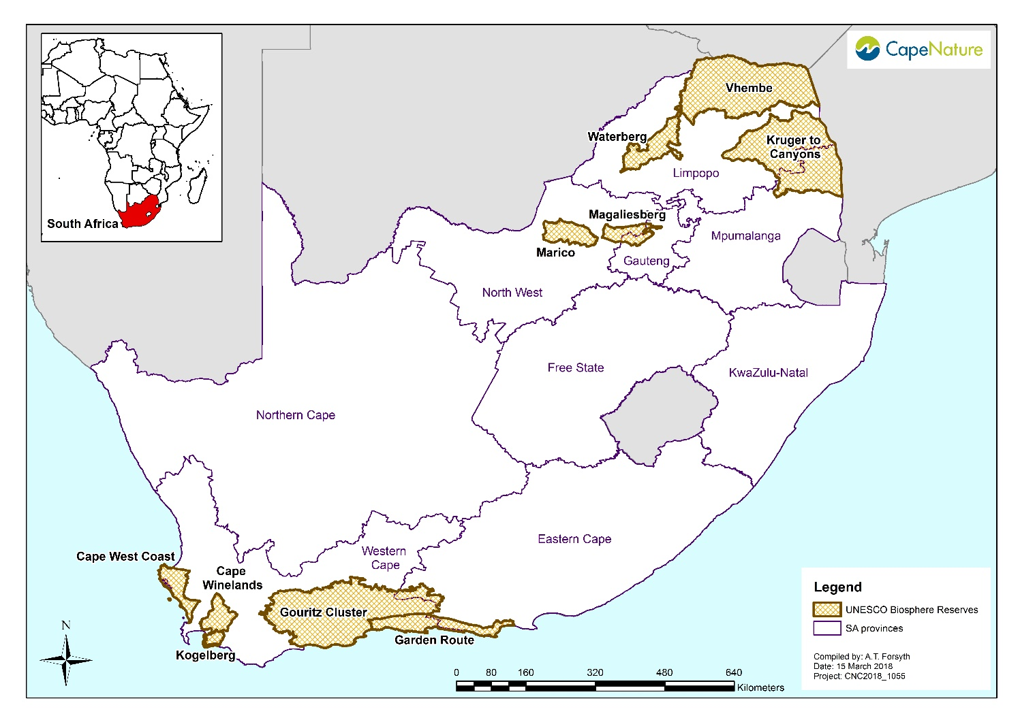
Landscape scale management: UNESCO MAB Programme
Dresden Declaration (2011) confirming: BRs are instruments for mitigating climate change
4th World Congress on Biosphere Reserves Lima, March 2016
Confirming: BRs are models for sustainable development
Lima Action Plan is showing the way forward
Notes:
Apart from setting aside benchmark sites through protected area designation, there is a need for sustainable landscape scale management
UNESCO’s MAB Programme offers an excellent model towards practising sustainable development
SA has 8 BRs with one to be designated this year (Garden Route), collectively covering 9.2% of SAs land area
BRs offer a holistic approach to landscape management. Some of the values relating to BRs are social inclusion, environmental protection, and to provide an economic base for people of the region. This year, SA will be drafting a document on the value generated by the MAB Programme and BRs in the country. This will be done in collaboration with UNESCO Harare. Thanks to them for their professional assistance and support to the MAB in SA.

Slide 15
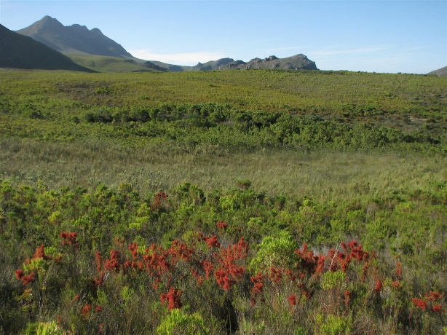
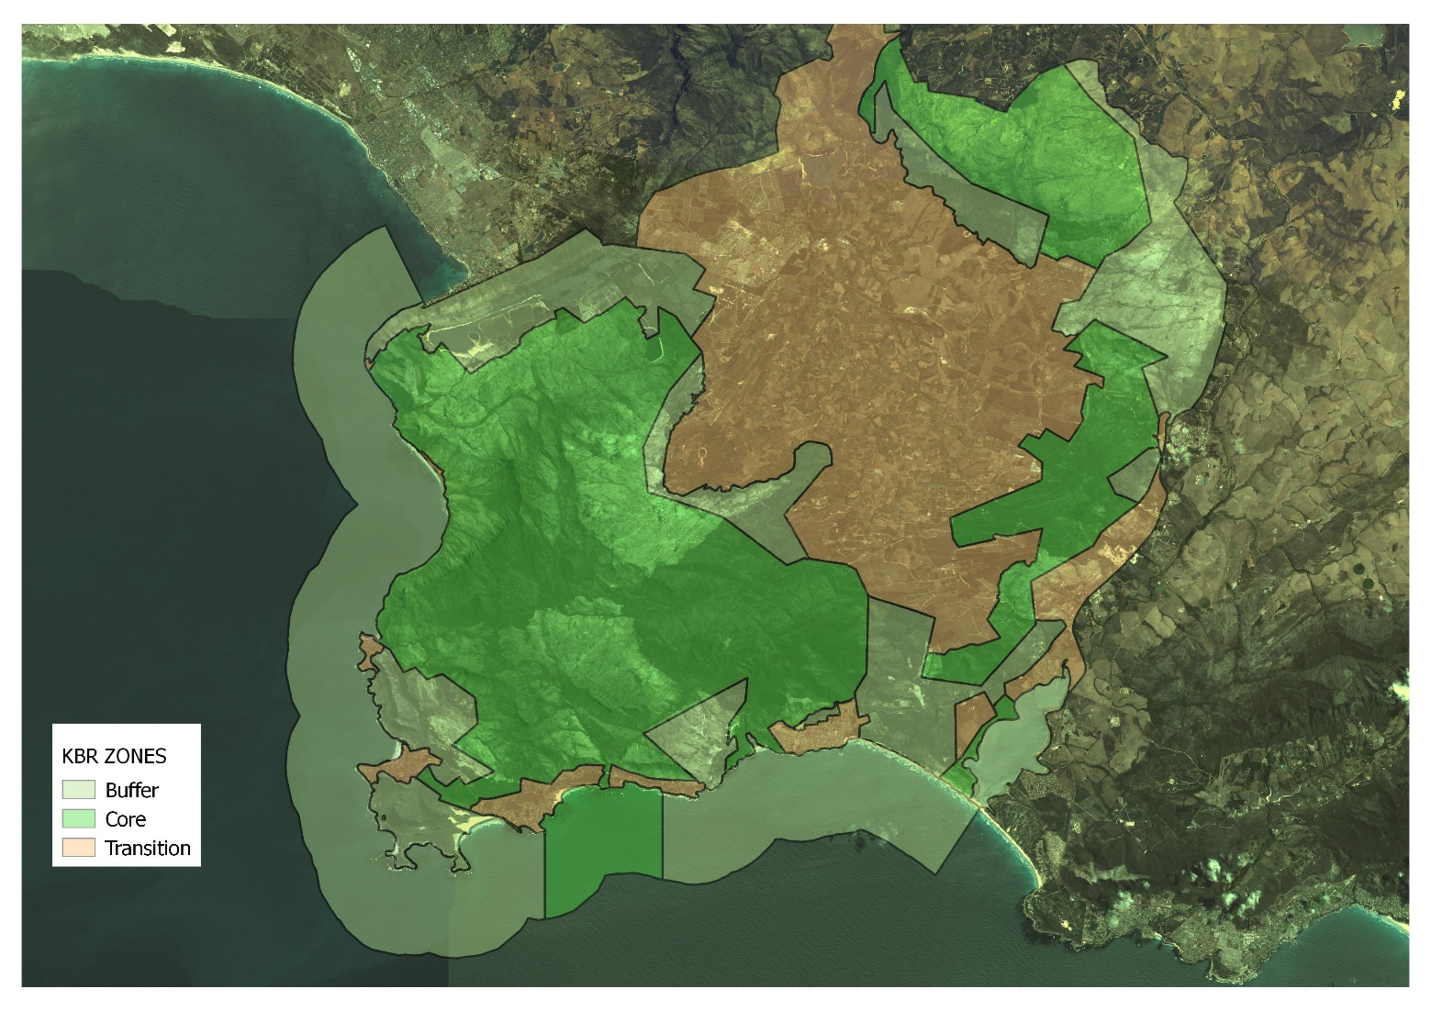
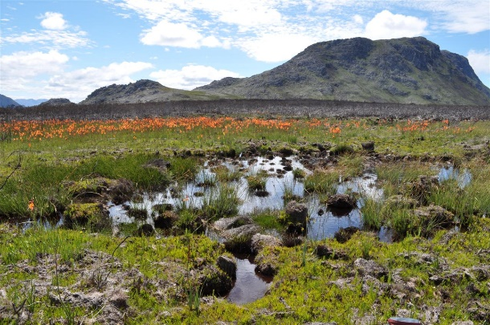
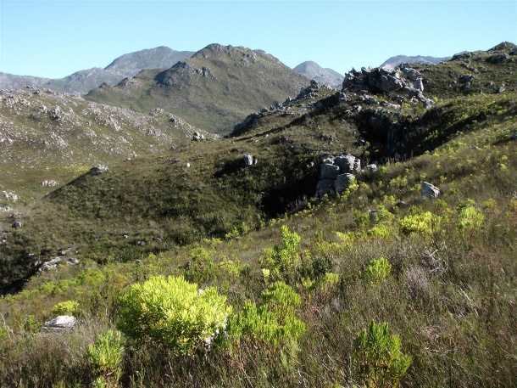
Kogelberg Biosphere Reserve
UNESCO designation in 1998; 2 x 10-year reviews
103 629 ha terrestrial and marine
Management entity = KBR Company (non-profit)
Board of Directors, Management Committee

Slide 16
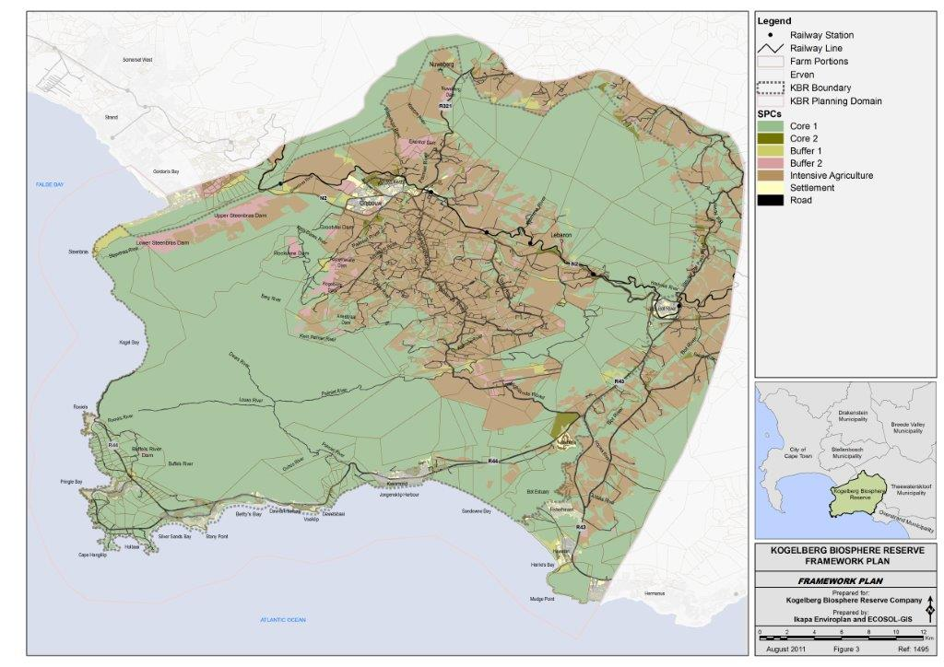

Slide 17
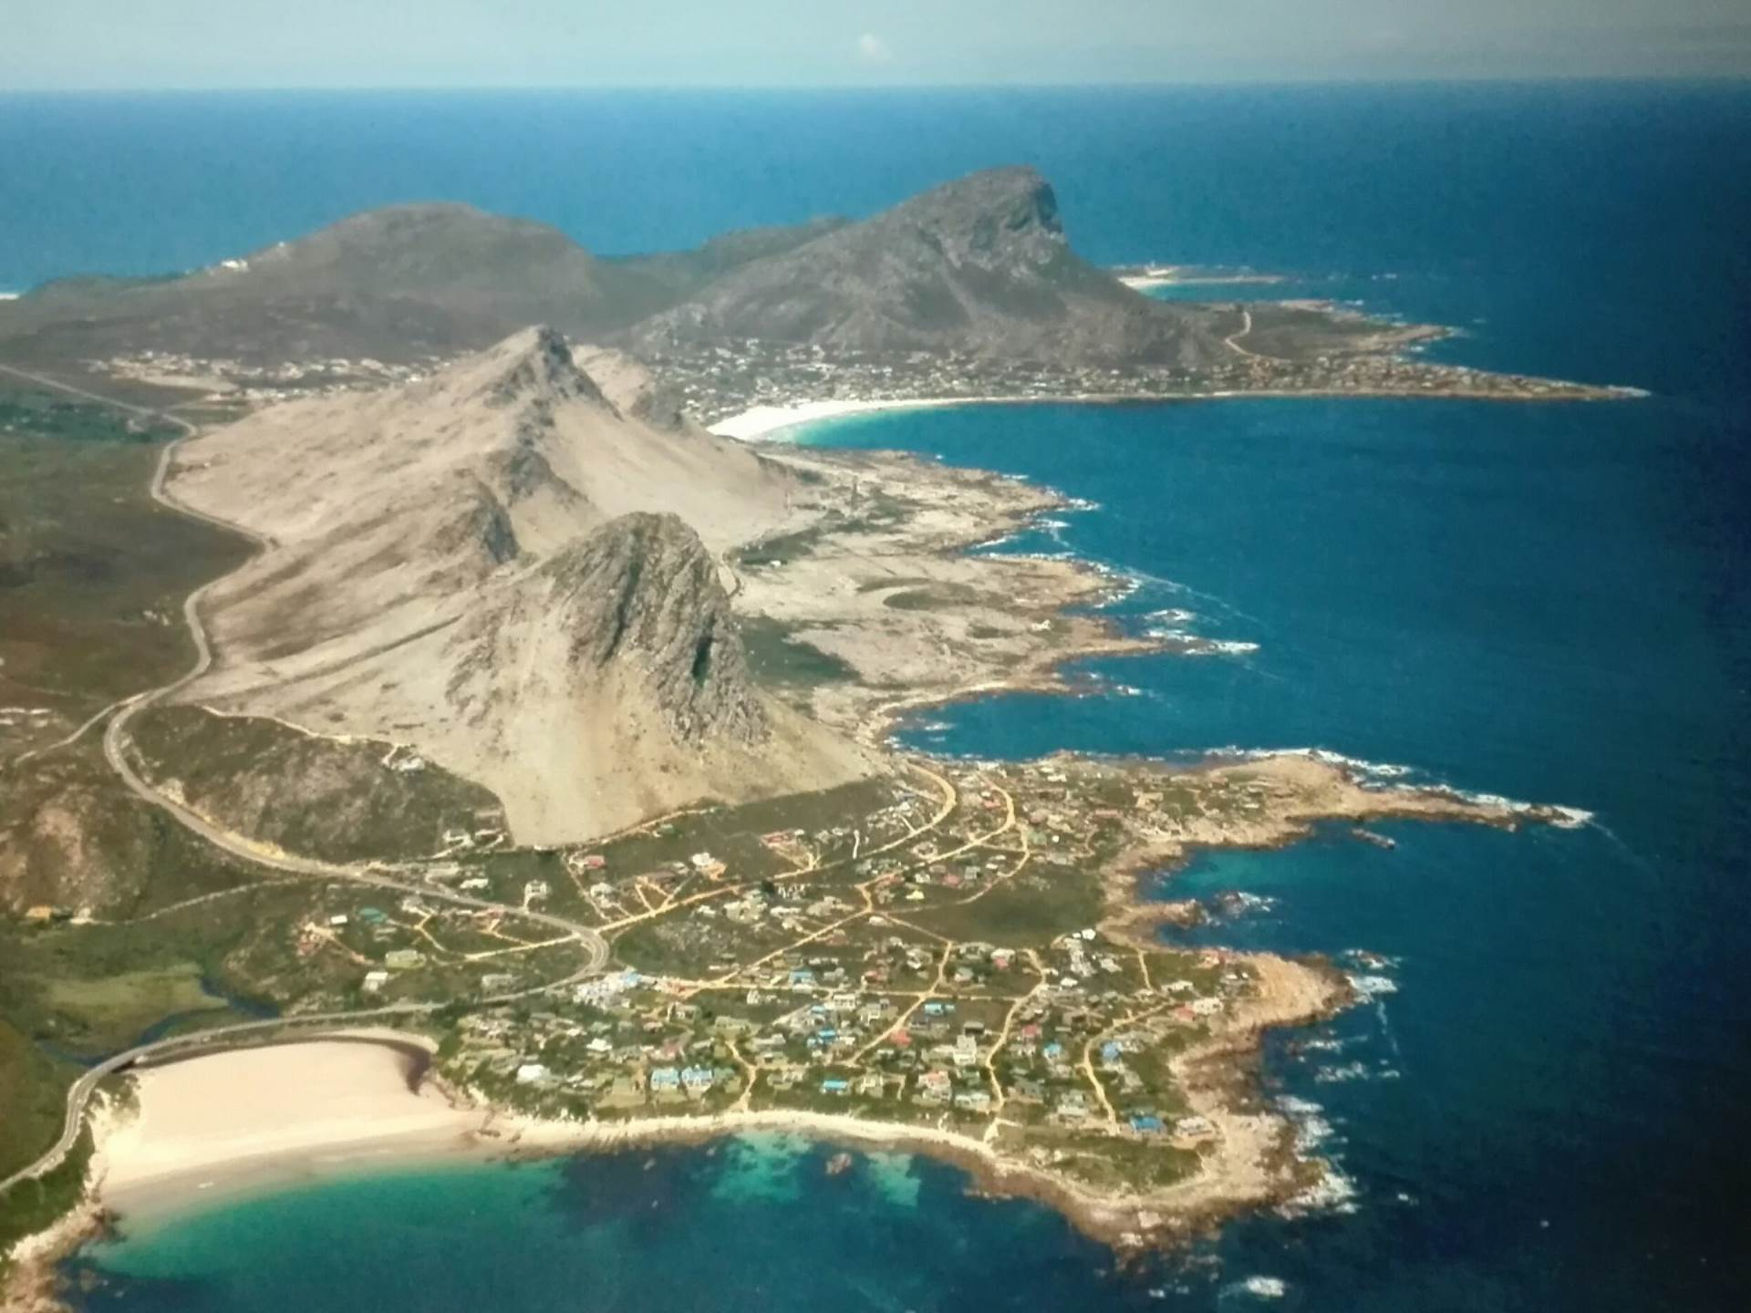
KBR Coastal Villages

Slide 18
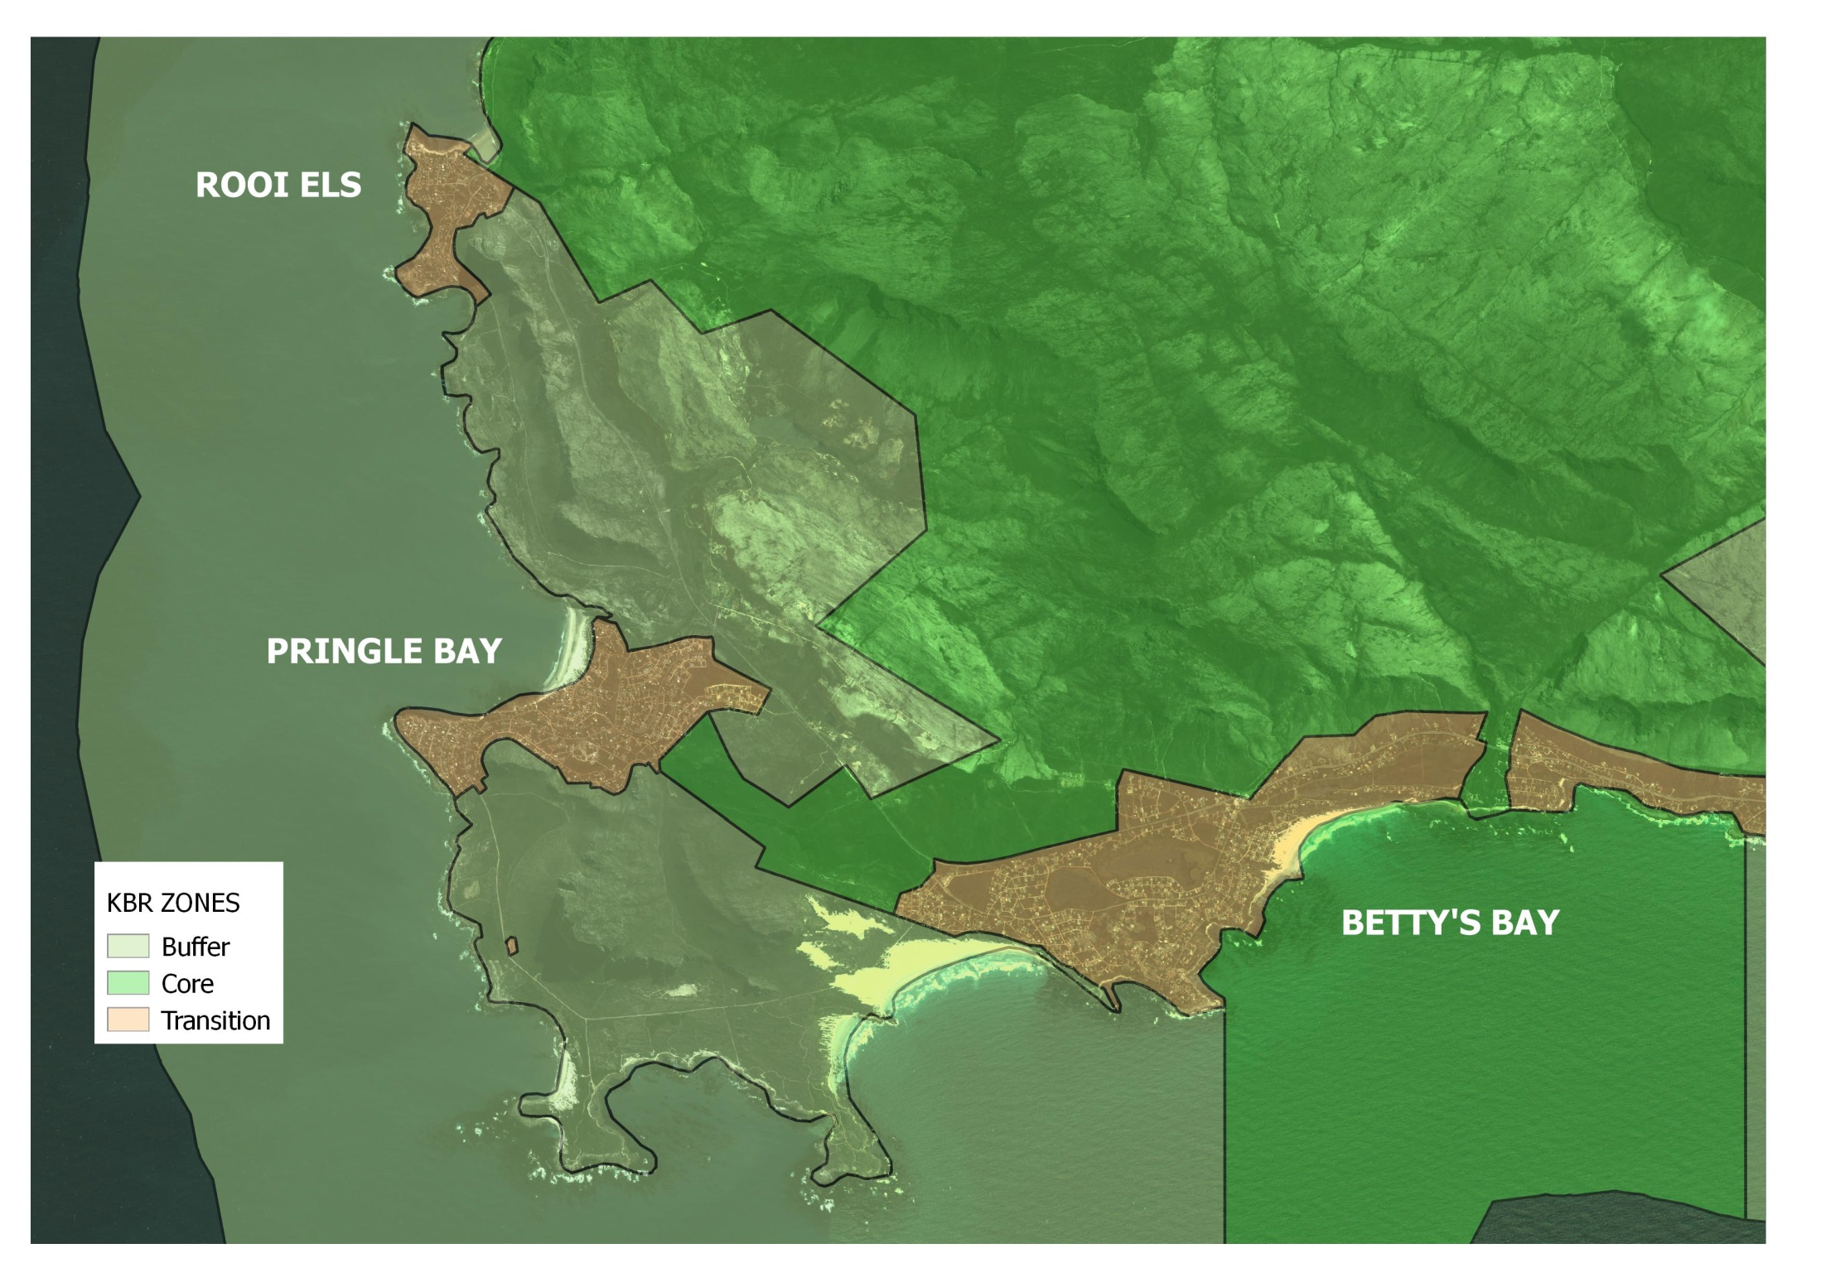

Slide 19
Buffer Zones
Seville Strategy and Statutory Framework
Surrounds or adjoins the core
Clearly delineated
Activities compatible with sound ecological practices
Private ownership
Mechanisms to manage human use
BR Handbook
All zones contribute to all 3 functions
Process of consultation and cooperation important in designing zonation
Could ensure connectivity
More intensive human activities than core
Rationale to be explained
Villages could be present
KBR Spatial Plan
Core 1, Core 2, Buffer 1, Buffer 2, Intensive Agriculture, Settlement
All forms of settlements included in Settlement SPC
Equals No Natural Area in WCape Biodiversity Spatial Plan

Slide 20
What to do?
Be Biosphere Champions!
Establish local Biosphere hub – information, research centre, preservation of Red Listed spp. (Boucher 1977, 1978)
biosphereresearch.org = research portal
Promote transdisciplinarity in decision-making
Assist with facilitation
Build firewise communities
Promote eco-friendly living practices
Create awareness through communication
Act as a servicing agency for local interests

Slide 21
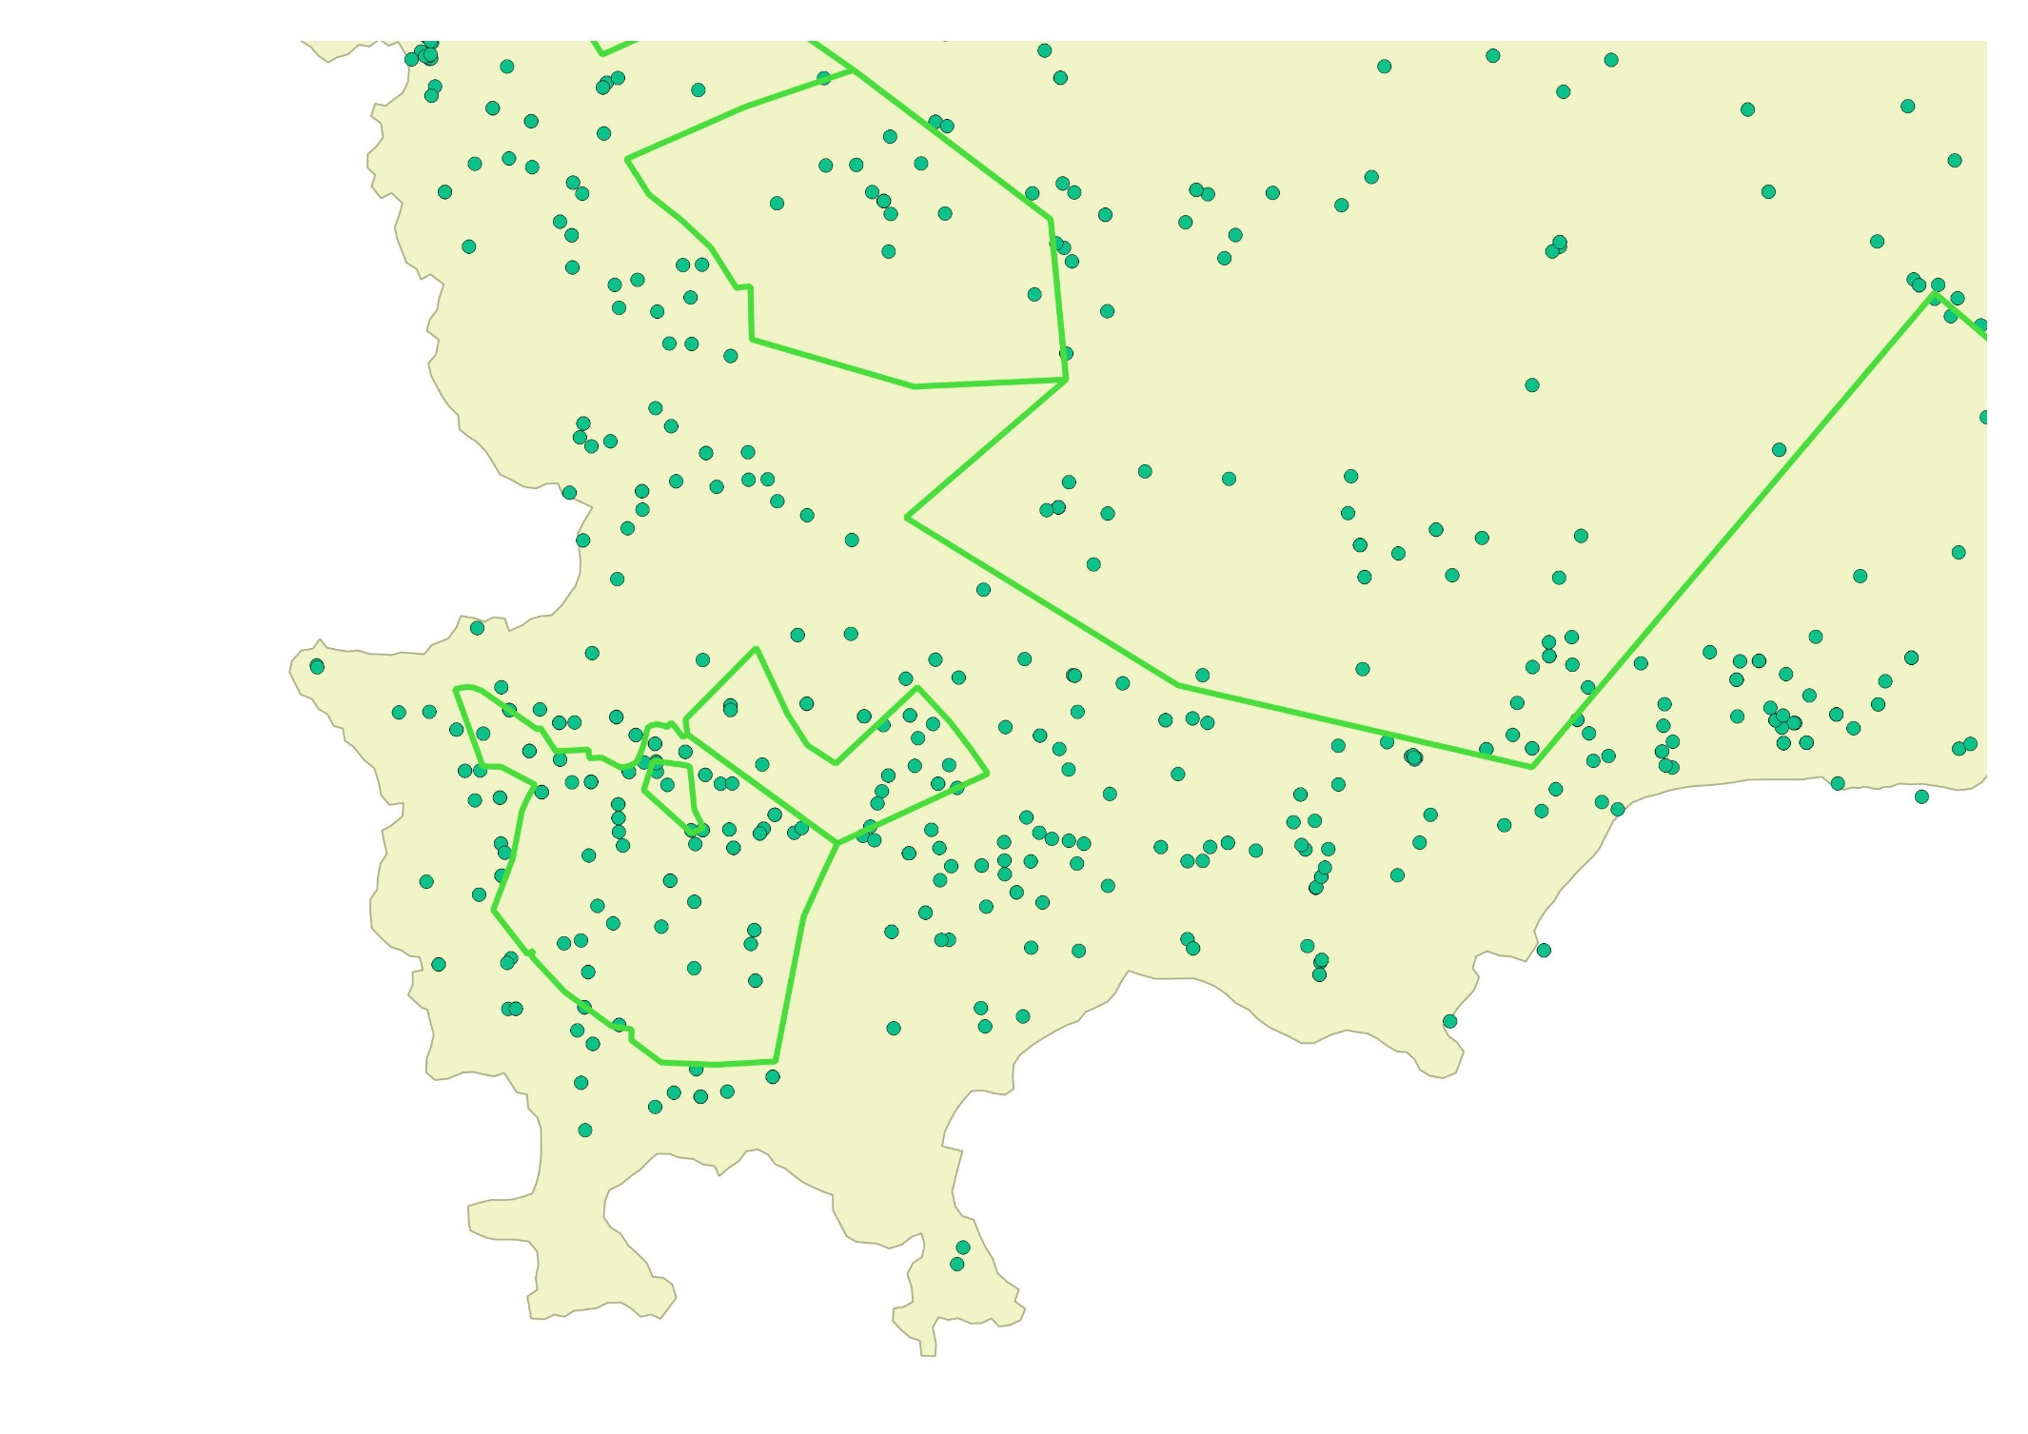
Red Listed plant species point localities

Slide 22
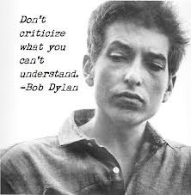
Awareness and Communication
Environmental changes and the impact on livelihoods
Climate change
Biodiversity extinctions
Water crisis
Ecological infrastructure
Population increase
Overutilization
Sustainable development
Notes:
Communication and awareness building is of the most crucial importance
We need to understand the social systems in order to find the best ways of communicating and educating about important issues such as this list

Slide 23
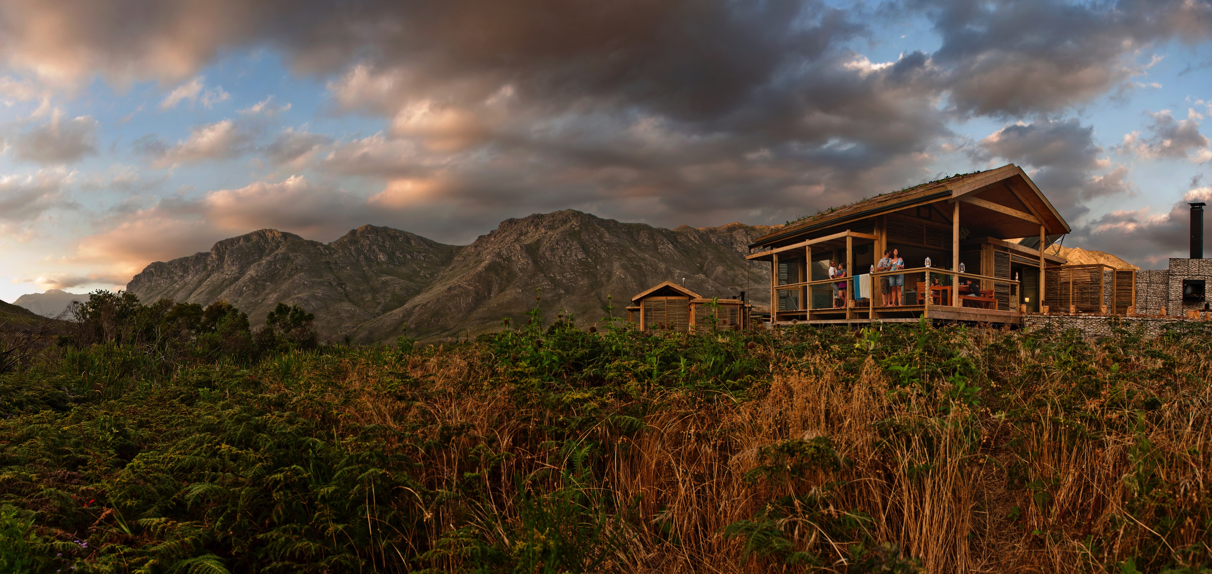
Closing
MAB Programme = land management option in support of sustainable social-ecological development (=SES)
BRs are “special places for people and nature”
Be active KBR partner
Create awareness through spreading the news
Rooi Els Conservancy sufficient to promote and ensure sustainable living practices
10 yr review ideal for buffer motivation

Slide 24
Thank you!!
rstanvliet@capenature.co.za

