Slide 1
RERA Working Group Sub-Group 2 Environment
Rooiels in the Biosphere – Report to Stakeholder on Buffer Zone and efforts to take forward
Why we would like all Rooiels included in the HPOZ and EMOZ
Comments on the Zoning Map
Information Briefs on Living in Rooiels

Slide 2
Biosphere Reserves
The Core zone in the middle protected from human activity to conserve nature and wilderness – conserve biodiversity, water catchments
The Buffer zone to provide additional protection and act as a refuge – people adapt to conserving indigenous seed banks and adapt to living with wild animals
The Transition zone are towns, villages, industry and farms that agree to limit their impact but humans come first

Slide 3
Why is RERA Researching Rooiels as Kogelberg Biosphere Buffer Zone
2018 Stakeholders meeting – request for RERA to apply for Rooiels to be included in Buffer Zone
Documentation and potential explored – see Report Back
Currently Rooiels is in the Transition zone and is not able to motivate for actions that are specific to Rooiels Vision
Rooiels would like to retain its nature and its role in biodiversity in supporting the KBR
Rooiels can become a Research node for the KBR and the Overstrand – academic tourism, appeal for research ideas

Slide 4
What does this mean for residents
Entrenching what Rooiels is already doing to live its Vision
Ensure we retain indigenous fynbos as seed banks for future and habitat for insects and animals and adapt to living with wildlife
still have any plants in own garden provided not alien invasives
encourage locally indigenous fynbos, esp. endemic plants
continue the good work of the hack and of the cameras etc
reduce impact of fences and walls on animals and aesthetics
ensure good waste management “green-living” and baboons/wildlife
marine zone buffer: recreational and artisan fishing allowed – no large vessels
Why: to ensure that nature is nurtured and our heritage protected

Slide 5
Conserving genetic diversity on land and sea in Rooiels

Slide 6
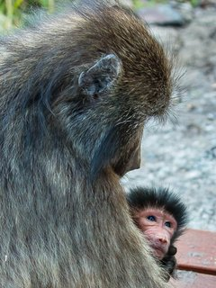
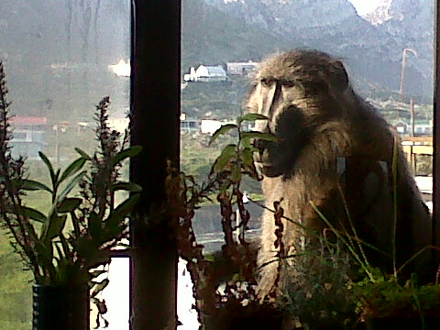
Living with wild animals in Rooiels

Slide 7
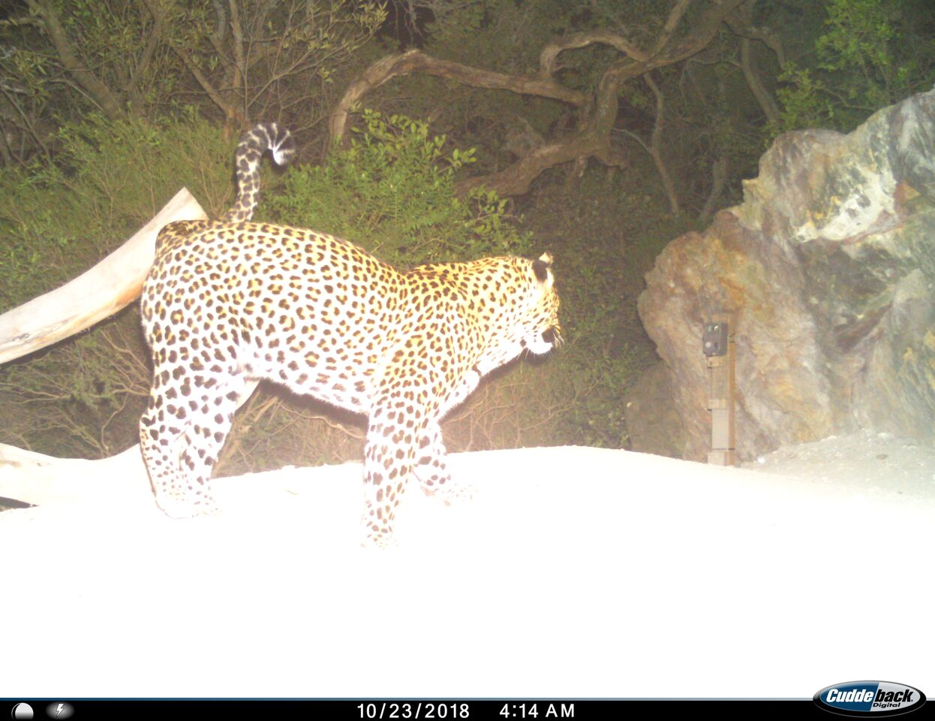
Leopards visit the cameras

Slide 8
Overstrand Municipal Overlay Zones and Planning
Ensure protection of key vulnerable - Heritage Protection Overlay Zones (HPOZ) and Environment Management Overlay Zone (EMOZ)
HPOZ for aesthetics, for cultural or historical – enhance tourism
EMOZ – mountain, estuary, coastal and buffer
Rooiels Overstrand Municipality proposed: All within site of R44, alongside Klein Hangklip and alongside the coast and the smallholdings – but excludes centre so is not all Rooiels
Thanks to OM for foresight in establishing Overlay Zones and all the work gone into them. Strongly endorse their efforts protecting Overstrand for future and for the Rooiels HPOZ and Buffer EMOZ
Correction of the Zoning Map – existing map is appropriate not the one included with amendments

Slide 9
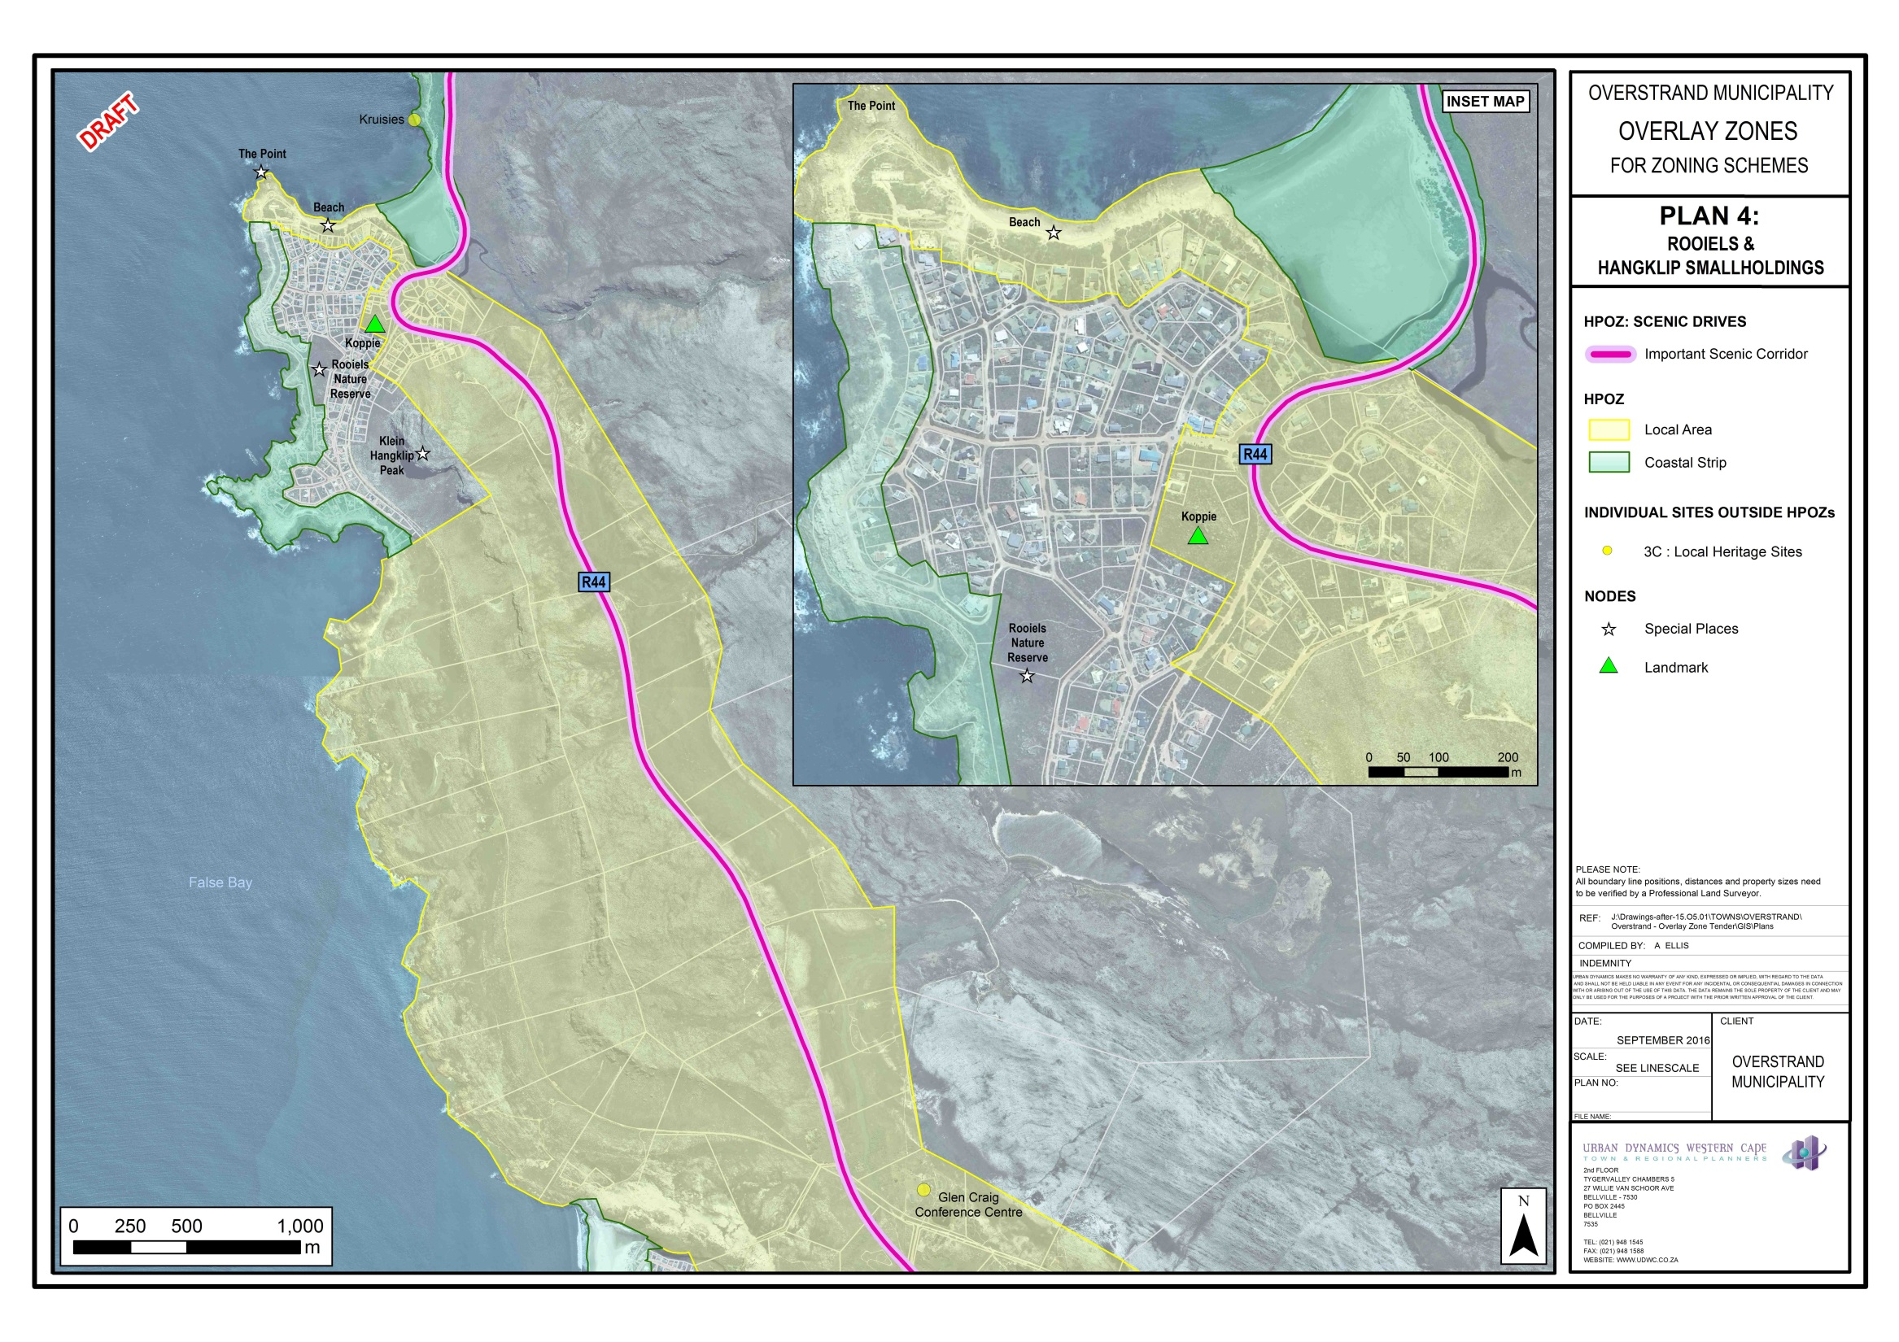

Slide 10
BUT Please Include All of Rooiels in HPOZ and EMOZ
Would like to see ALL Rooiels included and not just parts – request extend the Rooiels HPOZ to all Rooiels and the Buffer EMOZ also to extend beyond Klein Hangklip, Nature Reserve and Smallholdings to all Rooiels
Small community prefer cohesion – All Rooiels important to aesthetic heritage as Gateway to the Overstrand (village living with nature) and all provides environmental buffer to KBR (seed banks, animal habitat)
OM HPOZ mainly restrictions on new buildings to fit in better with aesthetics and retain scenic and natural quality of route
Working group requesting some additional specific applications to apply to Rooiels

Slide 11
Encouraging, Informing, Sharing
Many new residents come into Rooiels without knowing about the unique environment; what they are buying into and the importance of our heritage and commitment to living closely with nature. This custodial role contributes to biodiversity, the broader Overstrand economy and to retaining and enhancing property values but mostly to our own quality of life and values
A series of Information Briefs have been drafted. Please read them and provide ideas, feedback, edits to improve them.
Firewise, Wild Animals in Rooiels, Living with Baboons, Our Fynbos, Alien Invasives and the Hack, still to come Green Living Green Building, Birds, Seashore, Fishing and any other suggestions please?

Slide 12
Rooielsers working to protect the KBR, our water and then eradicating aliens

Slide 13
Rooiels Visie
​ROOI ELS IS 'N BEWARINGSGEMEENSKAP ​ wat Vandag saam sorg ... vir Môre ​ ONS WAARDES Ons streef daarna om 'n gemeenskap te wees wat omgee, verenig in ons passie om die natuurlike prag van Rooiels te bewaar en ywerig om ons waardering vir die omgewing met ander te deel ONS ONDERNEMING Verenig in ons passie vir die natuurprag van Rooiels Onderneem ons dat hier: Die natuur Gekoester sal word... Plante, diere en seelewe Beskerm sal word... Elke impak van ons op hierdie gebied, Beperk sal wees… Ons voogdyskap oor ons omgewing Gerespekteer sal word… Ons gemeenskapsgees Versterk sal word... Sodat ons lewens en die toekomstige geslagte Verryk

Slide 14
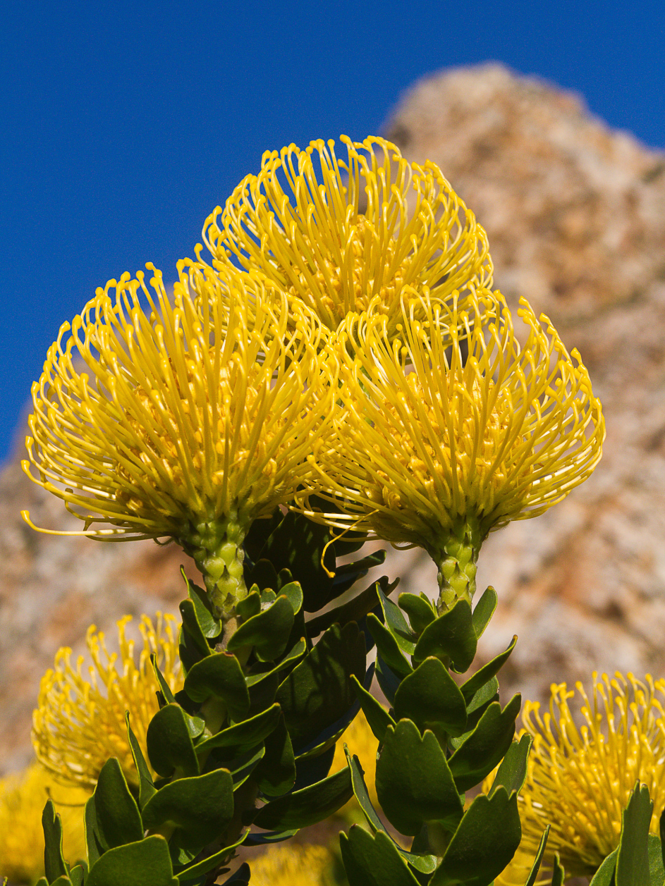
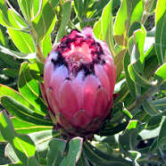
Proteaceae

